Slide 1
Windows System Administration
Telerik Software Academy
academy.telerik.com
Backup and Security Management
Borislav Varadinov
System Administrator
bobi@itp.bg

Slide 2
Backup and Recovery

Slide 3
Why Backup is important?
Software and Hardware failures are a common thing in the computer world. Any number of occurrences can cause loss of valuable data.
Types of failures
Power failures (software/hardware failure)
Natural disasters (fire, flood)
Security incidents (theft)
Hardware Failures (disk crash)
User error (rm -rf)
Social issues (stolen data)

Slide 4
What is Windows Backup Feature?
New tool for Vista and 2008
Upgraded in Windows 7 and 2008 R2
Provides basic backup and restore options
Must be installed with Server Manager
Can run manually or scheduled

Slide 5
Backup Roles and Software
Active Directory
DNS
Exchange
MS SQL

Slide 6
Backup Media
Optical Media (CD and DVD)
Hard Disks
No Tape
Network Share

Slide 7
Volume Shadow Copy Service (VSS)
Windows Backup Feature is based on Volume Shadow Copy Services (VSS)
Universal backup API for Windows
Can be used by third party
Point-in-time “snapshots” of a disk
Guaranteed consistency and file access

Slide 8
Windows RE Details
Based on Windows PE
Automatic recovery using Startup Repair
Auto-repairs >80% of boot failure causes
Leverages system instrumentation to diagnose driver errors and boot status
Manual recovery tools, including Complete PC restore
Bare metal or system state-only

Slide 9
Scheduling Backup
Scheduled backups give you the flexibility to run a backup at a particular time of the day, once per day, or multiple times per day
Before using the Backup Schedule Wizard, know:
What do you want to backup?
When and how often should the backup occur?
Where will backups be stored?

Slide 10
Data Recovery
You can recover files and folders, the system state, Active Directory, or the entire server from a backup
Windows Server Backup can recover only files, folders, and volumes
Command-line utilities used for more complete recovery
To start the recovery process, click recover in the Actions pane of Windows Server Backup

Slide 11
Perform a System Recovery
If full recovery is necessary, you need the Windows Server 2008 installation disk or access to Windows Recovery Environment (WinRE)
Can be installed on a server’s hard drive by pressing F8 when the boot process starts
Can also be accessed from the Windows Server 2008 installation DVD
You can restore a complete backup from a local or removable disk or a network location

Slide 12
Active Directory Backup
Active Directory is backed up when you perform a full backup of a domain controller or when you back up the volumes containing system recovery information
Restoration can be authoritative or nonauthoritative
Nonauthoritative restore restores the Active Directory database, or portions of it, and allows it to be updated through replication. Requires a restart into Domain Services Restore Mode (DSRM)
Authoritative restore ensures that restored objects aren’t overwritten by changes from other domain controllers through replication

Slide 13
Management Tools
Command line wbadmin
MMC

Slide 14
System Center Data Protection Manager (DPM)
Server based solution
Enables disk-based and tape-based data protection
Backup of
Active Directory, SQL Server, Exchange Server, SharePoint, virtual servers, file servers and Windows desktops
Support for Windows Azure Backup

Slide 15
Security

Slide 16
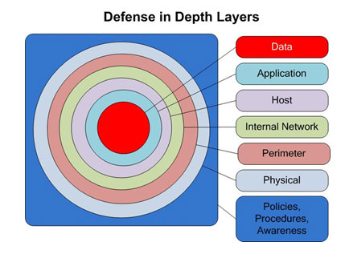
Defense in Depth

Slide 17
WSUS
Enables deployment of windows updates to:
Windows Client OS
Windows Server OS
Downloads information from Microsoft.com
Manage and Deploy distribution of updates and security patches
Can work as an update source (called upstream server)

Slide 18
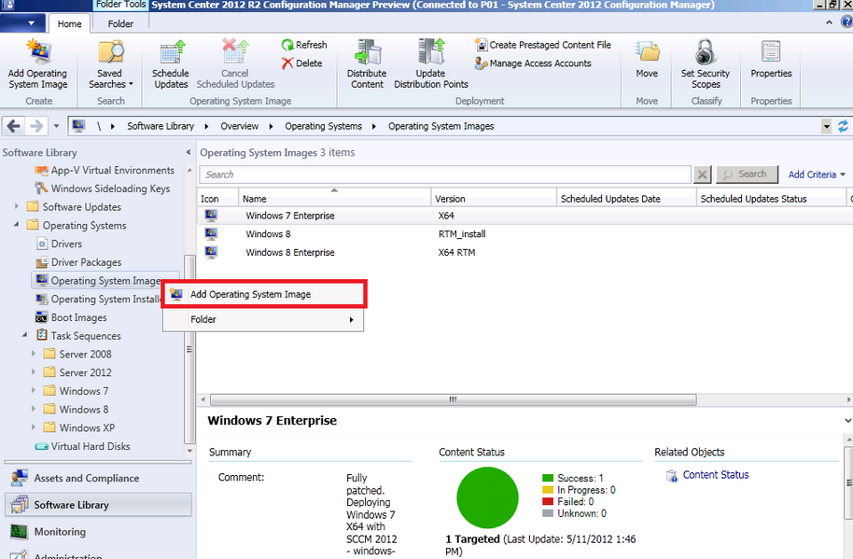
SCCM

Slide 19
Best Practice Analyzer
Best Practices guidelines
Scan and analyze the installed roles
Report best practice violations
Indicate server configurations that can result in poor server performance
Can be executed from PowerShell

Slide 20
Security Configuration Wizard
Create and apply a security policy
Disables unnecessary services
Enables firewall rules
Policies can be deployed by using Group Policy
Does not install or uninstall any components

Slide 21
Bitlocker
Integrated with the operating system
full disk encryption feature
Addresses the threats of data theft
Lost Computer
Stolen Computer
Inappropriately decommissioned computer
Trusted Platform Module (TPM)
Option to lock with PIN

Slide 22
EFS
Component of the NTFS file system
Enables transparent encryption and decryption of files
Files are protected even from those who gain physical access
Uses symmetric keys to encrypt data
Uses certificates to encrypt the symmetric keys
Requires good infrastructure

Slide 23
Windows Firewall
Mitigate some of the risks associated with unauthorized and potentially malicious access to host
Stateful host-based firewall
Blocks incoming connections
Blocks outgoing connections
IPsec connection security rules

Slide 24
Active Directory Rights Management Services (AD RMS)
Server Role
Require additional client licenses
Information protection technology
Safeguards digital information from unauthorized use
Consists server and a client component
Encrypts and decrypt content
Protects documents even outside your network

Slide 25
Best Practices
Protect your data
Set Password and Account Lockout polices
Protect your domain controllers
Backup your data and services
Protect your backups
Deny admin login to workstations
Deny logon locally for service accounts

Slide 26
Backup and Security Management
http://academy.telerik.com

Slide 27




Free Trainings @ Telerik Academy
"Web Design with HTML 5, CSS 3 and JavaScript" course @ Telerik Academy
html5course.telerik.com
Telerik Software Academy
academy.telerik.com
Telerik Academy @ Facebook
facebook.com/TelerikAcademy
Telerik Software Academy Forums
forums.academy.telerik.com

